Slide 1



Plan to produce strong evidence:
Bayesian Sequential Designs
Jörn Alexander Quent
MRC Cognition and Brain Sciences Unit
8th September 2020
@J_A_Quent
jaquent.me

Slide 2


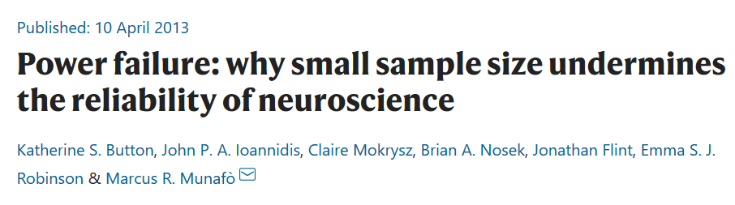
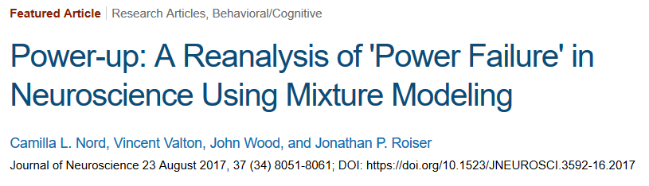

Open Science Reproducibility =

Slide 3
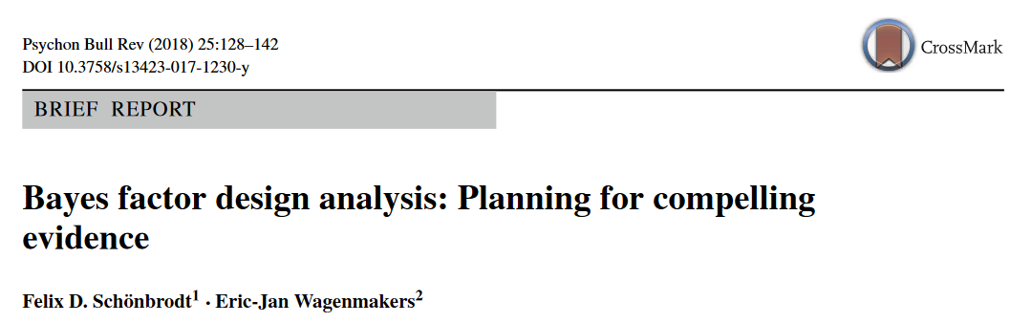
Open Science Reproducibility =
Bayesian stats allow us to provide evidence for null effects.
Traditional Bayesian fixed-n designs require huge sample sizes.
Bayesian Sequential Designs offer efficient way to produce strong evidence but saving resources.

Slide 4
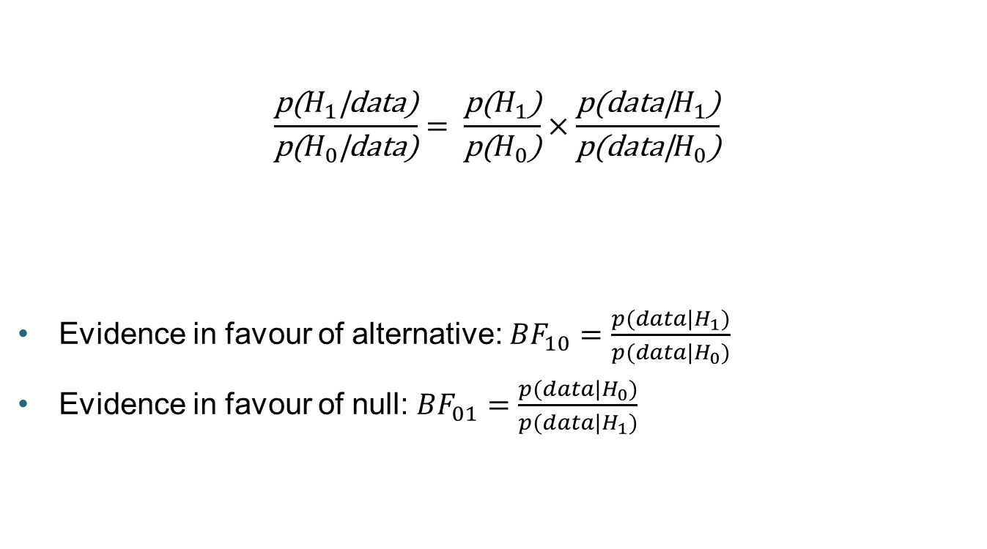
Bayesian Statistics
$$\frac{\text{p}\text{(}H_{1}\text{|}\text{data}\text{)}}{\text{p}\text{(}H_{0}\text{|}\text{data}\text{)}}= \frac{\text{p}\text{(}H_{1}\text{)}}{\text{p}\text{(}H_{0}\text{)}}×\frac{\text{p}\text{(}\text{data}\text{|}H_{1}\text{)}}{\text{p}\text{(}\text{data}\text{|}H_{0}\text{)}}$$
Evidence in favour of alternative: ${BF}_{10}=\frac{p(data|H_{1})}{p(data|H_{0})}$
Evidence in favour of null: ${BF}_{01}=\frac{p(data|H_{0})}{p(data|H_{1})}$
Prior plausibility about hypotheses
Posterior plausibility
Bayes factor

Slide 5
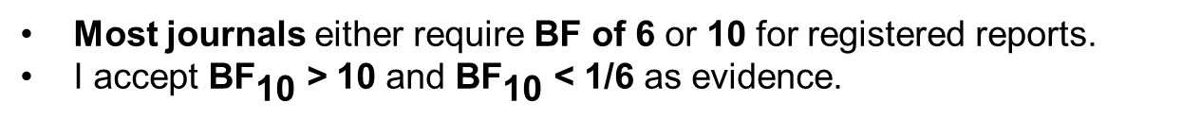
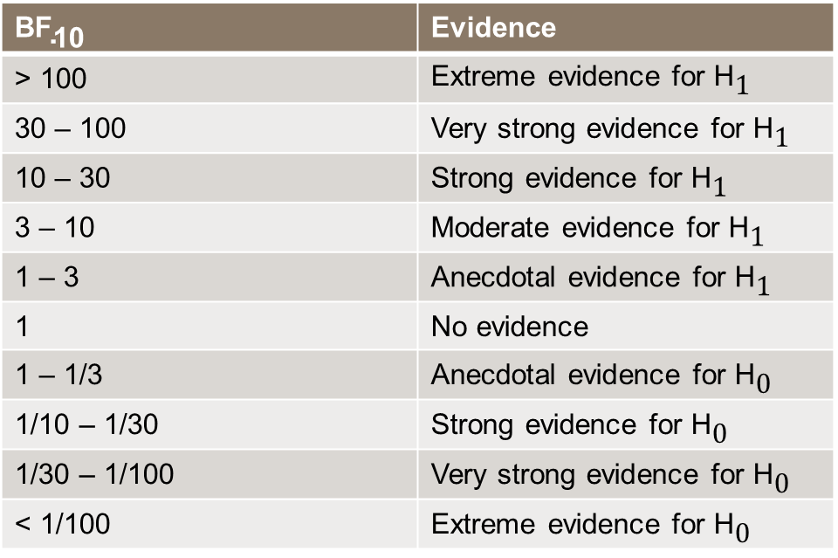
Convention for Bayes Factors
$${\text{BF}}_{\text{10}}$$ | Evidence
> 100 | Extreme evidence for ${\text{H}}_{\text{1}}$
30 – 100 | Very strong evidence for ${\text{H}}_{\text{1}}$
10 – 30 | Strong evidence for ${\text{H}}_{\text{1}}$
3 – 10 | Moderate evidence for ${\text{H}}_{\text{1}}$
1 – 3 | Anecdotal evidence for ${\text{H}}_{\text{1}}$
1 | No evidence
1 – 1/3 | Anecdotal evidence for ${\text{H}}_{\text{0}}$
1/10 – 1/30 | Strong evidence for ${\text{H}}_{\text{0}}$
1/30 – 1/100 | Very strong evidence for ${\text{H}}_{\text{0}}$
< 1/100 | Extreme evidence for ${\text{H}}_{\text{0}}$
Most journals either require BF of 6 or 10 for registered reports.
I accept ${\text{BF}}_{\text{10}}$ > 10 and ${\text{BF}}_{\text{10}}$ < 1/6 as evidence.

Slide 6
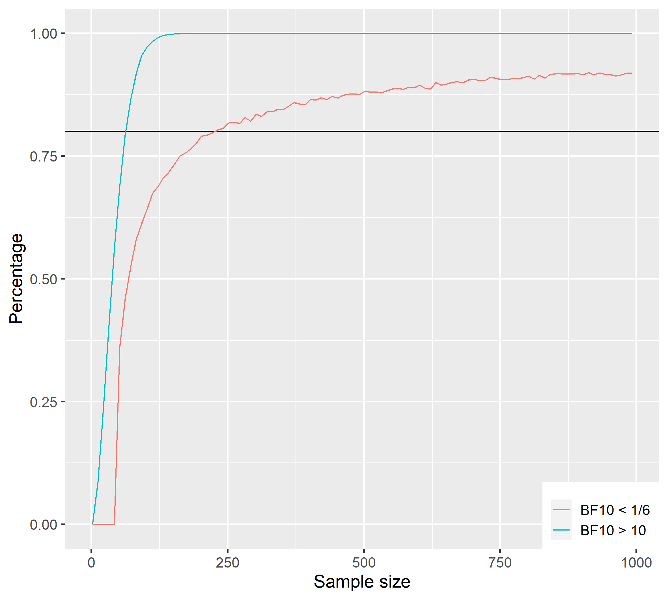
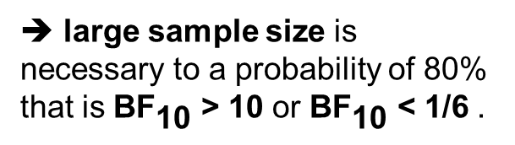
Traditional fixed-n design
➔ large sample size is necessary to a probability of 80% that is ${\text{BF}}_{\text{10}}$ > 10 or ${\text{BF}}_{\text{10}}$ < 1/6 .
Effect size | Necessary sample size | Misleading evidence | Costs online experiment | Costs fMRI experiment
0.5 | 72 | 0.0003 % | £ 605 | £ 39600
0.0 | 232 | 0.0011 % | £ 1949 | £ 127600

Slide 7
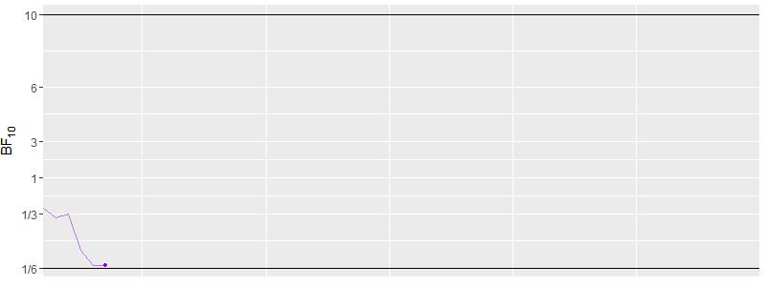

Sequential design
Start with a minimum sample size (e.g. 10).
Add data (e.g. 5 new points) until we reach ${\text{BF}}_{\text{10}}$criterion.

Slide 8
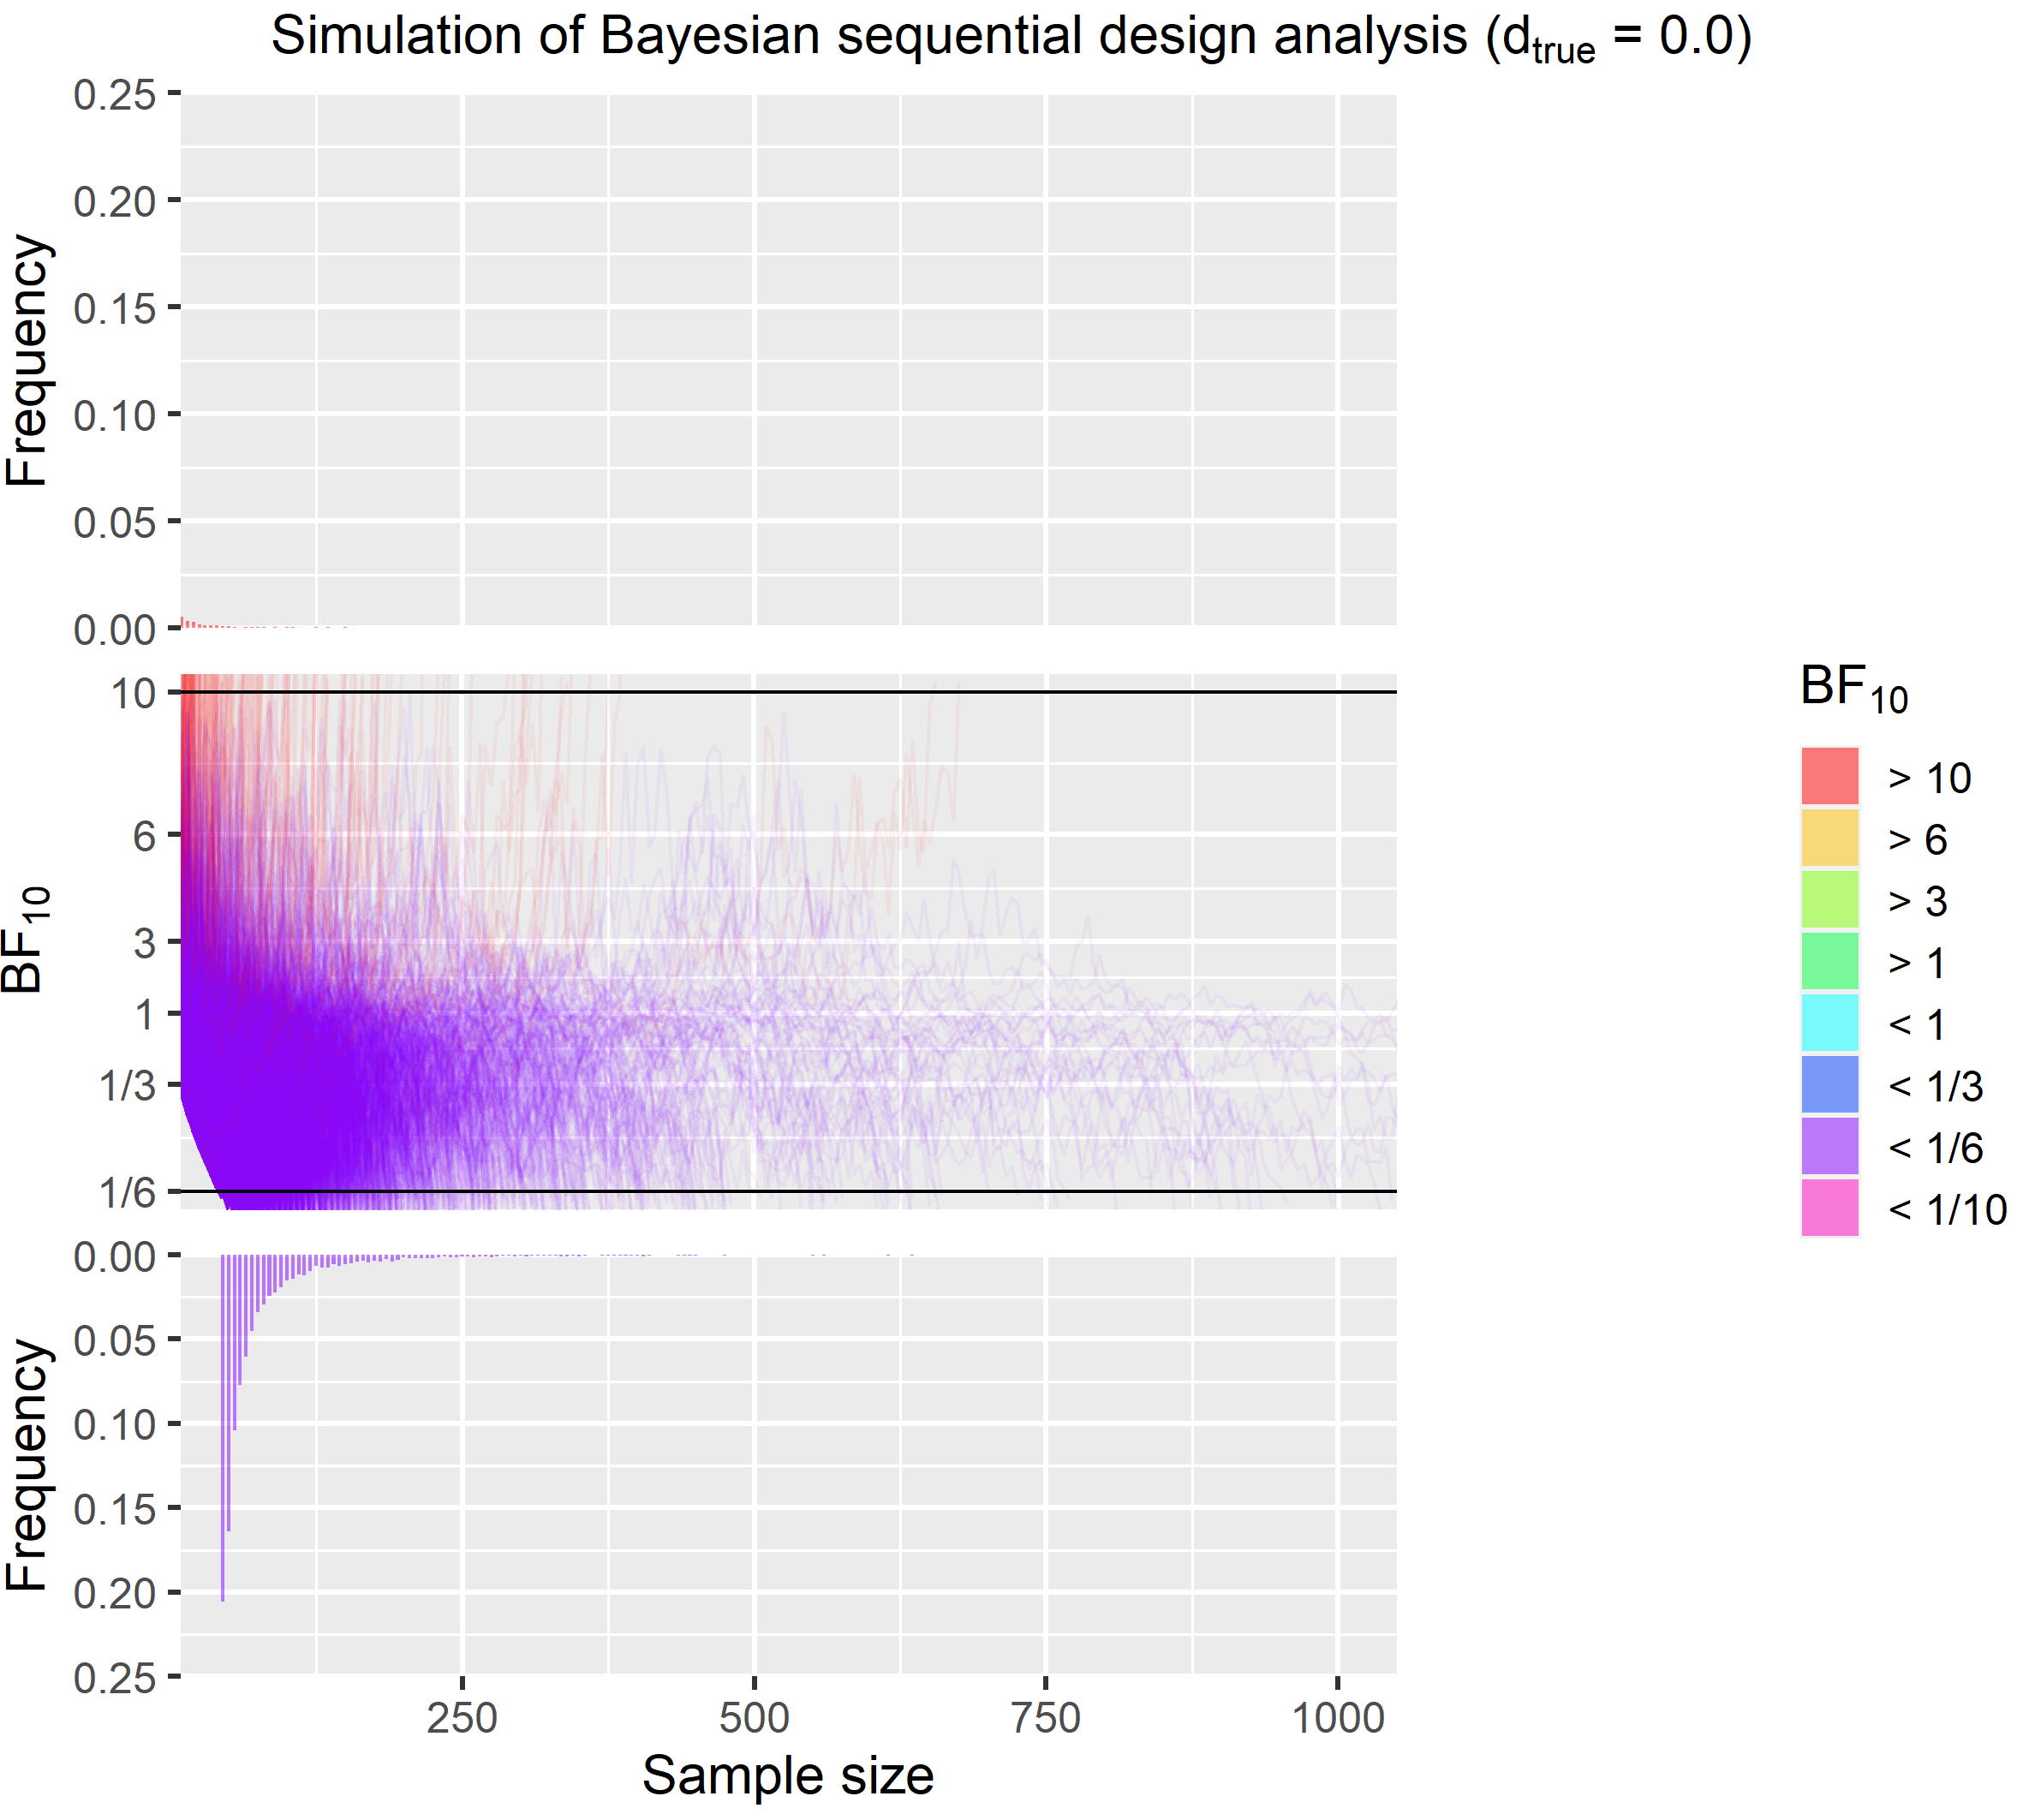
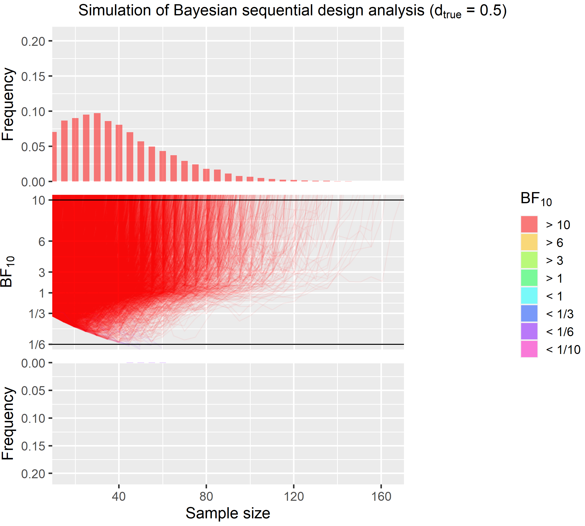
Sequential design
Effect size | Average sample size | Maximal sample size | Misleading evidence
0.5 | 41 | 170 | 0.13 %
0.0 | 83 | 2765 | 2.95 %

Slide 9
Comparison: Traditional vs. Sequential
Costs for traditional designs:
Cost for sequential design:
Guaranteed to provide strong evidence.
Average sample sizes are much lower.
Effect size | Necessary sample size | Misleading evidence | Costs online experiment | Costs fMRI experiment
0.5 | 72 | 0.0003 % | £ 605 | £ 39600
0.0 | 232 | 0.0011 % | £ 1949 | £ 127600
Effect size | Average sample size | Maximal sample size | Misleading evidence | Costs online experiment | Costs fMRI experiment
0.5 | 41 | 170 | 0.13 % | £ 344 | £ 22550
0.0 | 83 | 2765 | 2.95 % | £ 697 | £ 45650

Slide 10
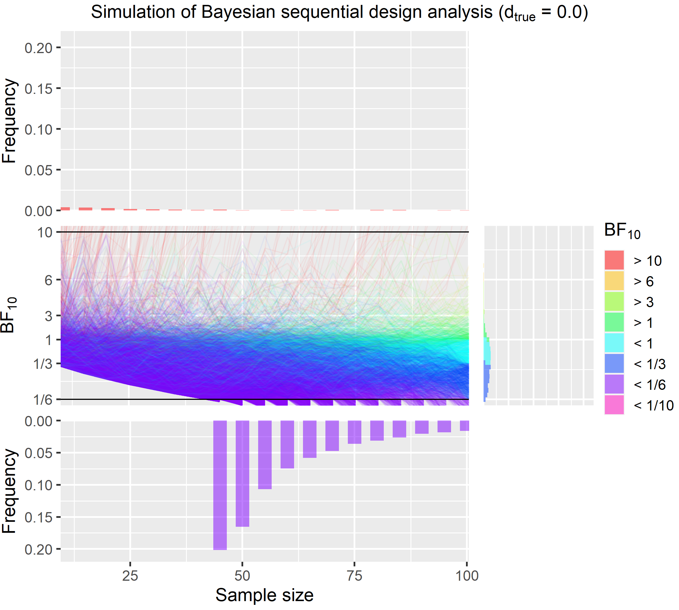
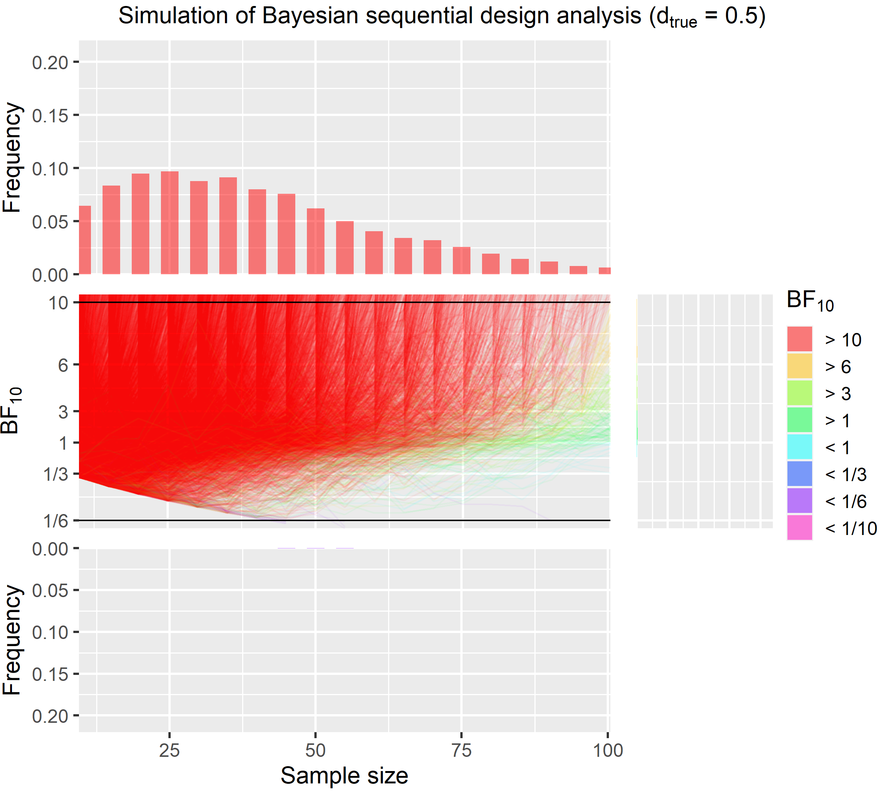
Setting an upper limit
Effect size | Average sample size | Maximal sample size | Strong evidence | Misleading evidence
0.5 | 39 | 100 | 98.05 % | 0.12 %
0.0 | 58 | 100 | 80.25 % | 2.31 %

Slide 11
Conclusion
Bayesian sequential designs are a useful tool to provide strong evidence while saving resources.

Slide 12
Special issue in Psychonomic Bulletin & Review volume: Bayesian methods for advancing psychological science
Schönbrodt, F. D., & Wagenmakers, E.-J. (2018). Bayes factor design analysis: Planning for compelling evidence. Psychonomic Bulletin & Review, 25(1), 128–142. https://doi.org/10.3758/s13423-017-1230-y
Etz, A., & Vandekerckhove, J. (2018). Introduction to Bayesian Inference for Psychology. Psychonomic Bulletin & Review, April 2017, 5–34. https://doi.org/10.3758/s13423-017-1262-3
Wagenmakers, E.-J., Marsman, M., Jamil, T., Ly, A., Verhagen, J., Love, J., Selker, R., Gronau, Q. F., Šmíra, M., Epskamp, S., Matzke, D., Rouder, J. N., & Morey, R. D. (2018). Bayesian inference for psychology. Part I: Theoretical advantages and practical ramifications. Psychonomic Bulletin & Review, 25(1), 35–57. https://doi.org/10.3758/s13423-017-1343-3
All code can be found here. Further points and more simulations can be found here.

